Slide 1
Mining Graphs and Tensors
Christos Faloutsos
CMU

Slide 2
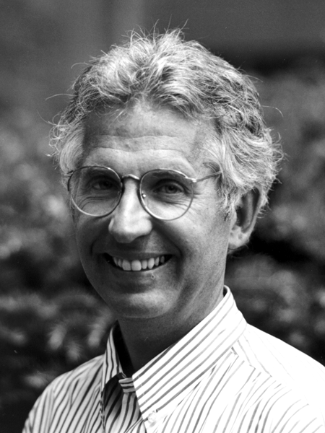
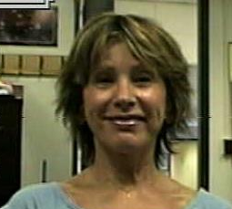
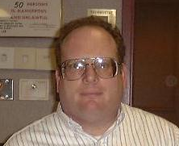
Thank you!
Charlie Van Loan
Lenore Mullin
Frank Olken

Slide 3
Outline
Introduction – Motivation
Problem#1: Patterns in static graphs
Problem#2: Patterns in tensors / time evolving graphs
Problem#3: Which tensor tools?
Problem#4: Scalability
Conclusions

Slide 4
Motivation
Data mining: ~ find patterns (rules, outliers)
Problem#1: How do real graphs look like?
Problem#2: How do they evolve?
Problem#3: What tools to use?
Problem#4: Scalability to GB, TB, PB?

Slide 5
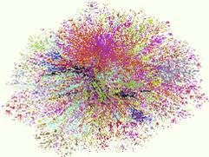
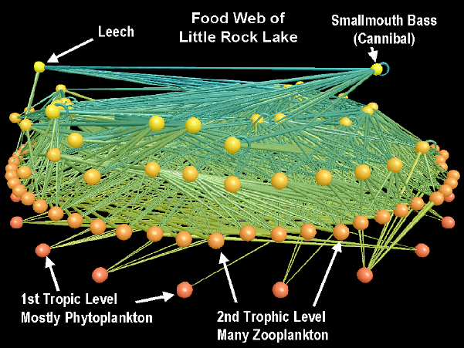
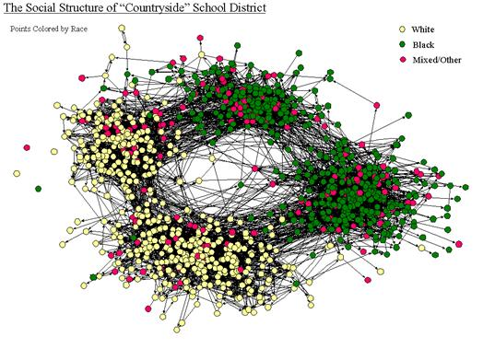
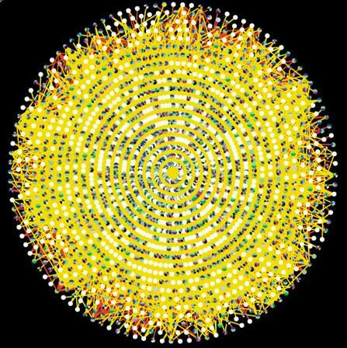
Graphs - why should we care?
Internet Map [lumeta.com]
Food Web [Martinez ’91]
Friendship Network [Moody ’01]
Protein Interactions [genomebiology.com]

Slide 6
Graphs - why should we care?
IR: bi-partite graphs (doc-terms)
web: hyper-text graph
... and more:
D₁
T₁
...
...
D_{N}
T_{M}

Slide 7
Graphs - why should we care?
network of companies & board-of-directors members
‘viral’ marketing
web-log (‘blog’) news propagation
computer network security: email/IP traffic and anomaly detection
....

Slide 8
Outline
Data mining: ~ find patterns (rules, outliers)
Problem#1: How do real graphs look like?
  Degree distributions
  Eigenvalues
  Triangles
  weights
Problem#2: How do they evolve?
…

Slide 9
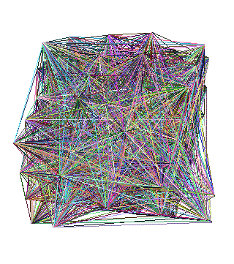
Problem #1 - network and graph mining
How does the Internet look like?
How does the web look like?
What is ‘normal’/‘abnormal’?
which patterns/laws hold?

Slide 10
Graph mining
Are real graphs random?

Slide 11
Laws and patterns
Are real graphs random?
A: NO!!
  Diameter
  in- and out- degree distributions
  other (surprising) patterns

Slide 12
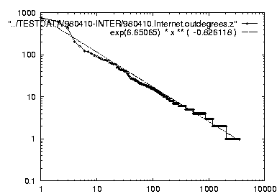
Solution#1.1
Power law in the degree distribution [SIGCOMM99]
internet domains
att.com
log(degree)
ibm.com
-0.82
log(rank)

Slide 13
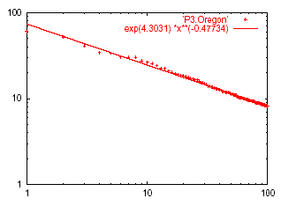
Solution#1.2: Eigen Exponent E
Eigenvalue
Exponent = slope
E = -0.48
May 2001
Rank of decreasing eigenvalue
A2: power law in the eigenvalues of the adjacency matrix

Slide 14
Solution#1.2: Eigen Exponent E
Eigenvalue
Exponent = slope
E = -0.48
May 2001
Rank of decreasing eigenvalue
[Mihail, Papadimitriou ’02]: slope is ½ of rank exponent

Slide 15
But:
How about graphs from other domains?

Slide 16
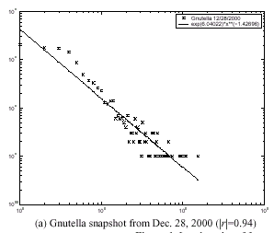
The Peer-to-Peer Topology
[Jovanovic+]
Count versus degree
Number of adjacent peers follows a power-law

Slide 17
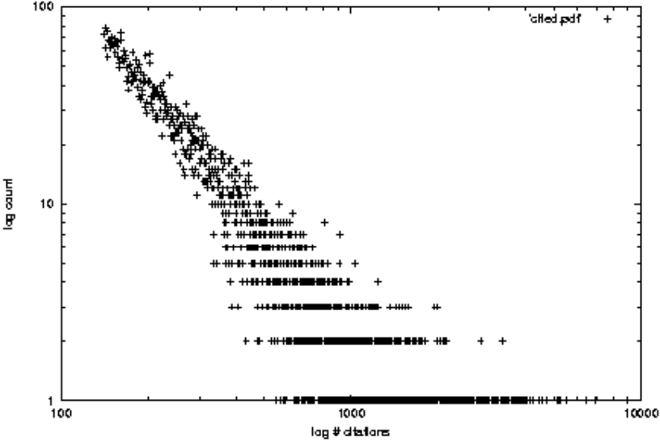
More settings w/ power laws:
citation counts: (citeseer.nj.nec.com 6/2001)
log(count)
Ullman
log(#citations)

Slide 18
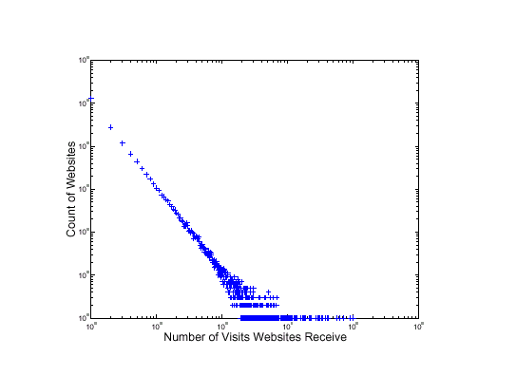
More power laws:
web hit counts [w/ A. Montgomery]
Web Site Traffic
log(count)
Zipf
``ebay’’
users
sites
log(in-degree)

Slide 19
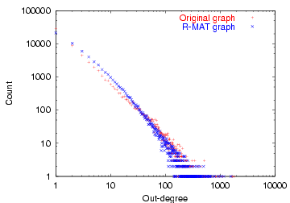
epinions.com
who-trusts-whom [Richardson + Domingos, KDD 2001]
count
trusts-2000-people user
(out) degree

Slide 20
Outline
Data mining: ~ find patterns (rules, outliers)
Problem#1: How do real graphs look like?
  Degree distributions
  Eigenvalues
  Triangles
  weights
Problem#2: How do they evolve?
…

Slide 21
How about triangles?

Slide 22
Solution# 1.3: Triangle ‘Laws’
Real social networks have a lot of triangles

Slide 23
Triangle ‘Laws’
Real social networks have a lot of triangles
  Friends of friends are friends
Any patterns?

Slide 24

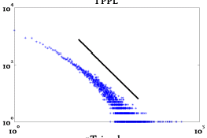
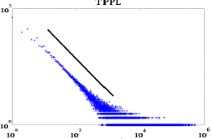
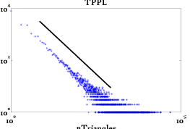
Triangle Law: #1
[Tsourakakis ICDM 2008]
HEP-TH
ASN
X-axis: # of Triangles
a node participates in
Y-axis: count of such nodes
Epinions
1-<number>

Slide 25
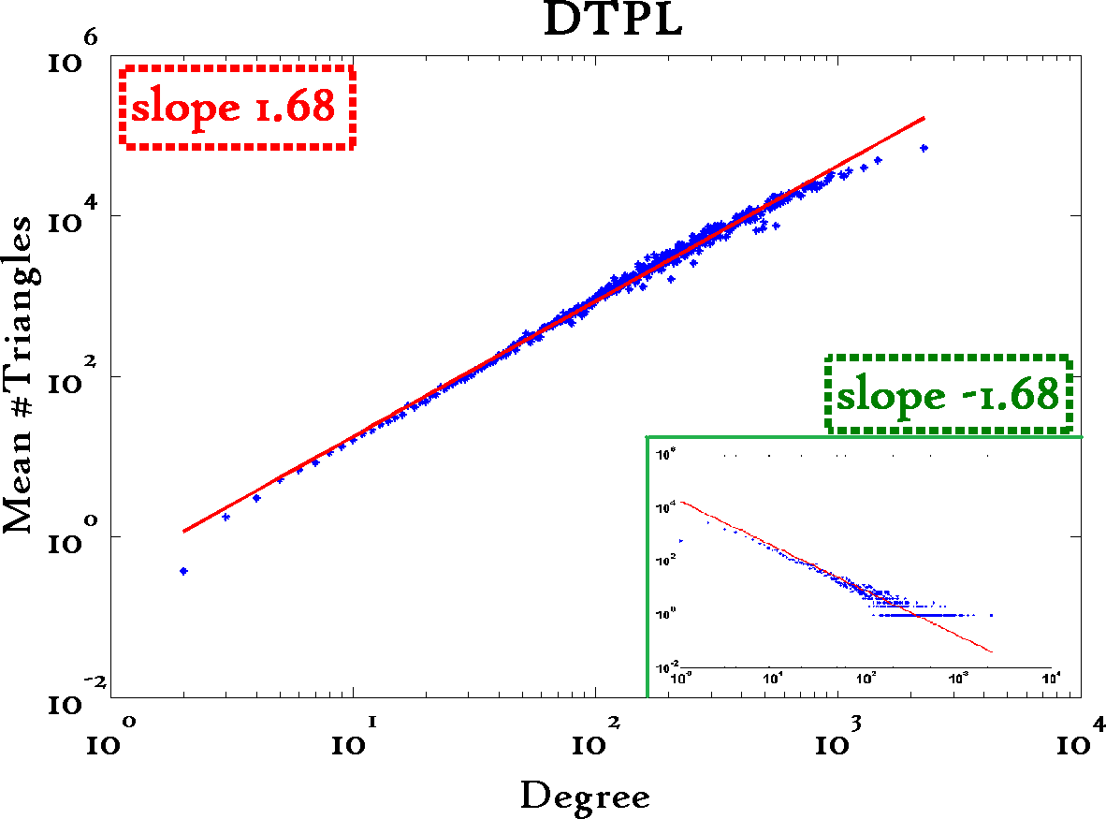
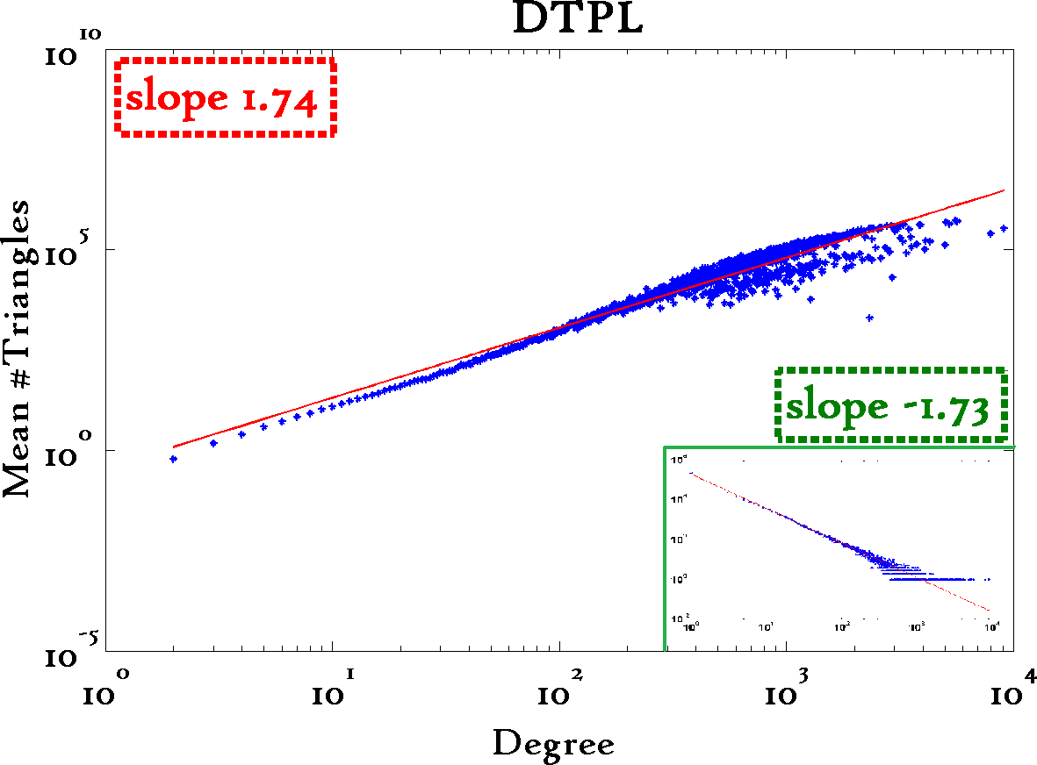
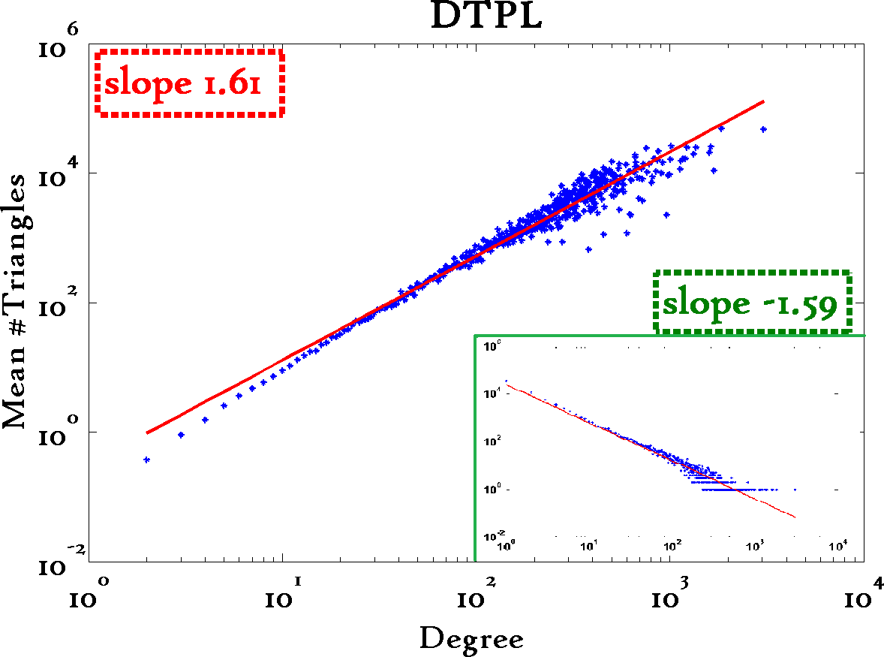
Triangle Law: #2
[Tsourakakis ICDM 2008]
Reuters
SN
X-axis: degree
Y-axis: mean # triangles
Notice: slope ~ degree
exponent (insets)
Epinions
CIKM’08
Copyright: Faloutsos, Tong (2008)
1-<number>

Slide 26
Triangle Law: Computations
[Tsourakakis ICDM 2008]
But: triangles are expensive to compute
(3-way join; several approx. algos)
Q: Can we do that quickly?
CIKM’08
1-<number>

Slide 27
Triangle Law: Computations
[Tsourakakis ICDM 2008]
But: triangles are expensive to compute
(3-way join; several approx. algos)
Q: Can we do that quickly?
A: Yes!
#triangles = 1/6 Sum ( λ_{i}³ )
(and, because of skewness, we only need
the top few eigenvalues!
CIKM’08
1-<number>

Slide 28
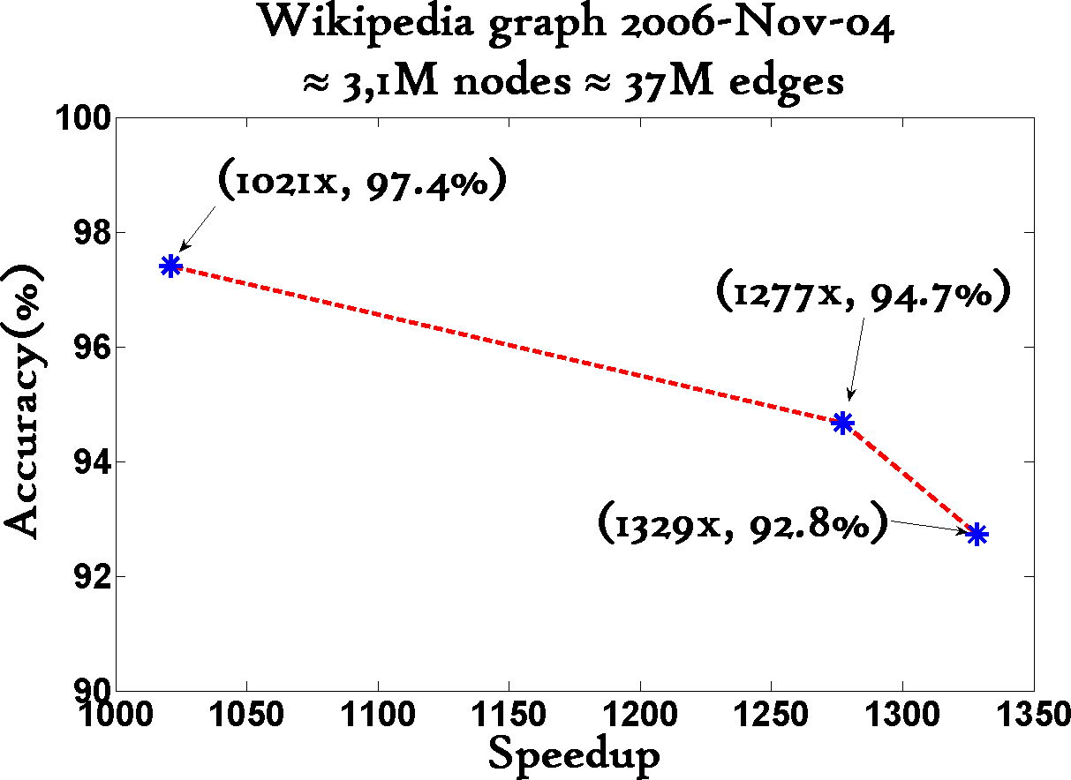
Triangle Law: Computations
[Tsourakakis ICDM 2008]
1000x+ speed-up, high accuracy
CIKM’08
1-<number>

Slide 29
Outline
Data mining: ~ find patterns (rules, outliers)
Problem#1: How do real graphs look like?
  Degree distributions
  Eigenvalues
  Triangles
  weights
Problem#2: How do they evolve?
…

Slide 30
How about weighted graphs?
A: even more ‘laws’!

Slide 31
Solution#1.4: fortification
  Q: How do the weights
  of nodes relate to degree?

Slide 32
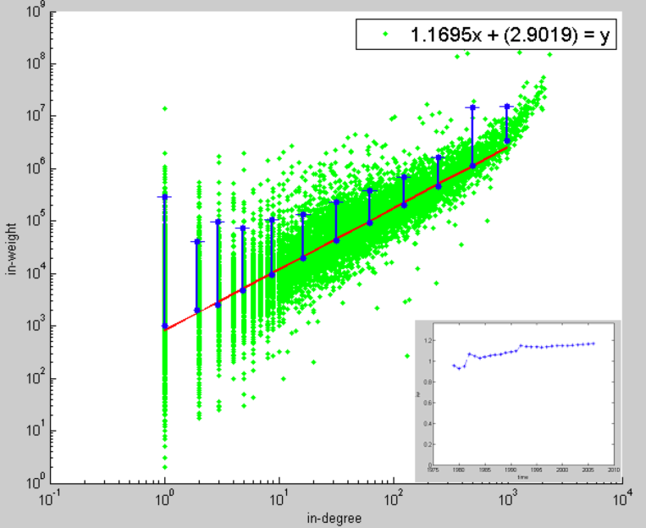
Solution#1.4: fortification:
Snapshot Power Law
At any time, total incoming weight of a node is proportional to in-degree with PL exponent ‘iw’:
  i.e. 1.01 < iw < 1.26, super-linear
More donors, even more $
Orgs-Candidates
In-weights
($)
e.g. John Kerry,
$10M received,
from 1K donors
Edges (# donors)
CIKM’08
Copyright: Faloutsos, Tong (2008)
1-<number>

Slide 33
Motivation
Data mining: ~ find patterns (rules, outliers)
Problem#1: How do real graphs look like?
Problem#2: How do they evolve?
  Diameter
  GCC, and NLCC
  Blogs, linking times, cascades
Problem#3: Tensor tools?
…

Slide 34

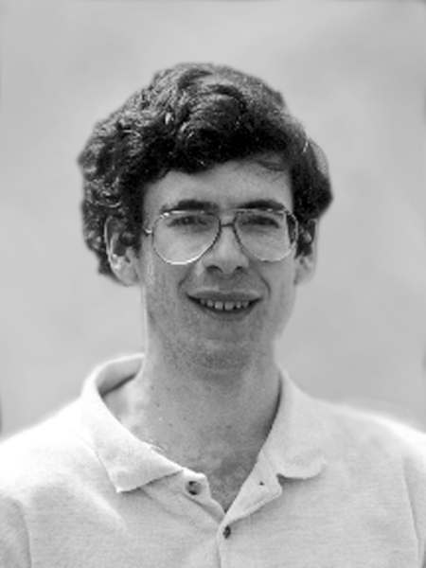
Problem#2: Time evolution
with Jure Leskovec (CMU/MLD)
and Jon Kleinberg (Cornell – sabb. @ CMU)

Slide 35
Evolution of the Diameter
Prior work on Power Law graphs hints at slowly growing diameter:
  diameter ~ O(log N)
  diameter ~ O(log log N)
What is happening in real data?
Notes:
Diameter first, DPL second
Check diameter formulas
As the network grows the distances between nodes slowly grow

Slide 36
Evolution of the Diameter
Prior work on Power Law graphs hints at slowly growing diameter:
  diameter ~ O(log N)
  diameter ~ O(log log N)
What is happening in real data?
Diameter shrinks over time
Notes:
Diameter first, DPL second
Check diameter formulas
As the network grows the distances between nodes slowly grow

Slide 37
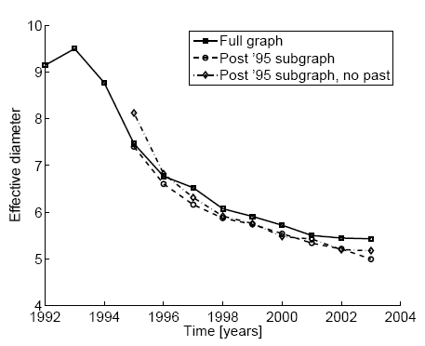
Diameter – ArXiv citation graph
Citations among physics papers
1992 –2003
One graph per year
diameter
time [years]

Slide 38
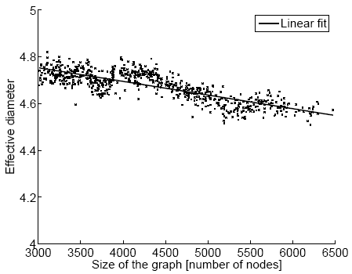
Diameter – “Autonomous Systems”
Graph of Internet
One graph per day
1997 – 2000
diameter
number of nodes

Slide 39
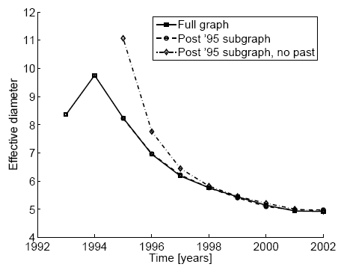
Diameter – “Affiliation Network”
Graph of collaborations in physics – authors linked to papers
10 years of data
diameter
time [years]

Slide 40
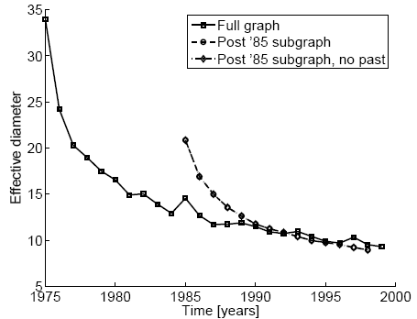
Diameter – “Patents”
diameter
Patent citation network
25 years of data
time [years]

Slide 41
Temporal Evolution of the Graphs
N(t) … nodes at time t
E(t) … edges at time t
Suppose that
  N(t+1) = 2 * N(t)
Q: what is your guess for
  E(t+1) =? 2 * E(t)

Slide 42
Temporal Evolution of the Graphs
N(t) … nodes at time t
E(t) … edges at time t
Suppose that
  N(t+1) = 2 * N(t)
Q: what is your guess for
  E(t+1) =? 2 * E(t)
A: over-doubled!
  But obeying the ``Densification Power Law’’

Slide 43
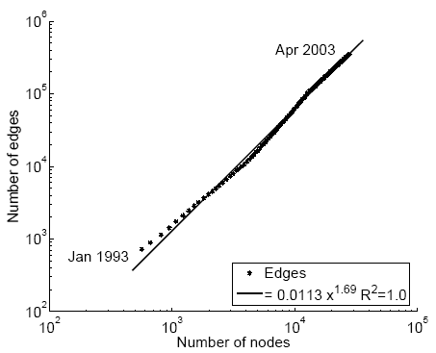
Densification – Physics Citations
Citations among physics papers
2003:
  29,555 papers, 352,807 citations
E(t)
??
N(t)

Slide 44
Densification – Physics Citations
Citations among physics papers
2003:
  29,555 papers, 352,807 citations
E(t)
1.69
N(t)

Slide 45
Densification – Physics Citations
Citations among physics papers
2003:
  29,555 papers, 352,807 citations
E(t)
1.69
1: tree
N(t)

Slide 46
Densification – Physics Citations
Citations among physics papers
2003:
  29,555 papers, 352,807 citations
E(t)
clique: 2
1.69
N(t)

Slide 47
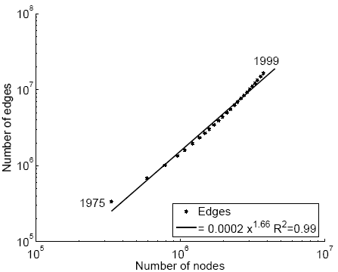
Densification – Patent Citations
Citations among patents granted
1999
  2.9 million nodes
  16.5 million edges
Each year is a datapoint
E(t)
1.66
N(t)

Slide 48
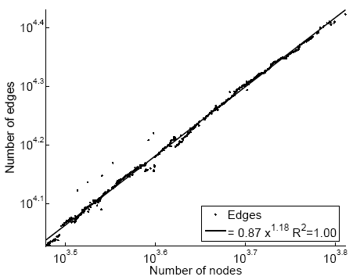
Densification – Autonomous Systems
Graph of Internet
2000
  6,000 nodes
  26,000 edges
One graph per day
E(t)
1.18
N(t)

Slide 49
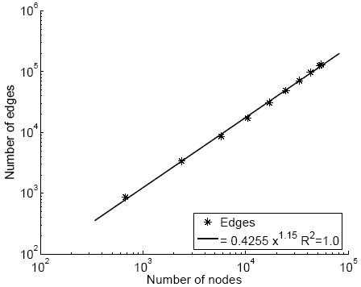
Densification – Affiliation Network
Authors linked to their publications
2002
  60,000 nodes
    20,000 authors
    38,000 papers
  133,000 edges
E(t)
1.15
N(t)

Slide 50
Motivation
Data mining: ~ find patterns (rules, outliers)
Problem#1: How do real graphs look like?
Problem#2: How do they evolve?
  Diameter
  GCC, and NLCC
  Blogs, linking times, cascades
Problem#3: Tensor tools?
…

Slide 51
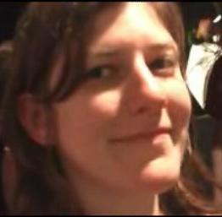
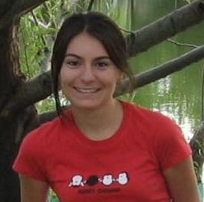
More on Time-evolving graphs
M. McGlohon, L. Akoglu, and C. Faloutsos
Weighted Graphs and Disconnected Components: Patterns and a Generator.
SIG-KDD 2008

Slide 52
Observation 1: Gelling Point
Q1: How does the GCC emerge?

Slide 53
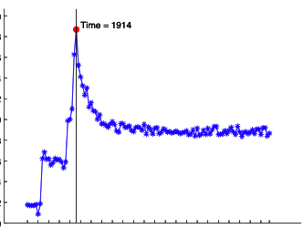
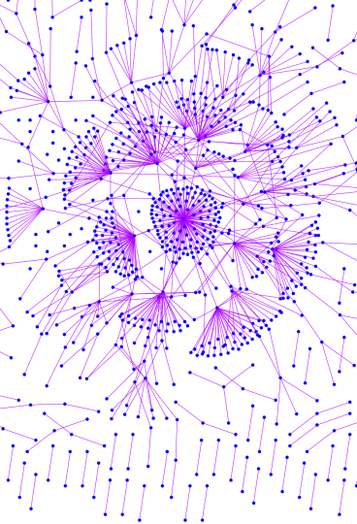
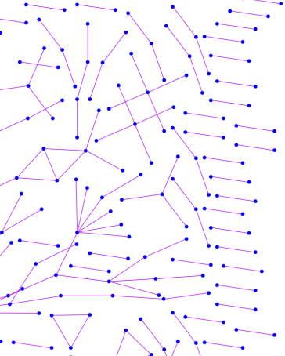
Observation 1: Gelling Point
Most real graphs display a gelling point
After gelling point, they exhibit typical behavior. This is marked by a spike in diameter.
IMDB
t=1914
Diameter
Time

Slide 54
Observation 2: NLCC behavior
  Q2: How do NLCC’s emerge and join with the GCC?
  (``NLCC’’ = non-largest conn. components)
  Do they continue to grow in size?
  or do they shrink?
  or stabilize?

Slide 55
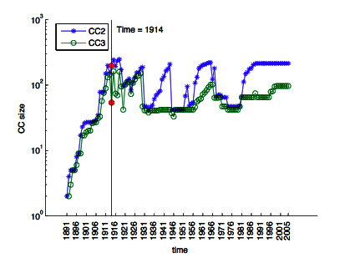
Observation 2: NLCC behavior
After the gelling point, the GCC takes off, but NLCC’s remain ~constant (actually, oscillate).
IMDB
CC size

Slide 56
How do new edges appear?
[LBKT’08] Microscopic Evolution of Social Networks
Jure Leskovec, Lars Backstrom, Ravi Kumar, Andrew Tomkins.
(ACM KDD), 2008.

Slide 57
How do edges appear in time?
[LBKT’08]
Edge gap δ(d): inter-arrival time between d^{th} and d+1st edge
δ
What is the PDF of δ?
Poisson?

Slide 58
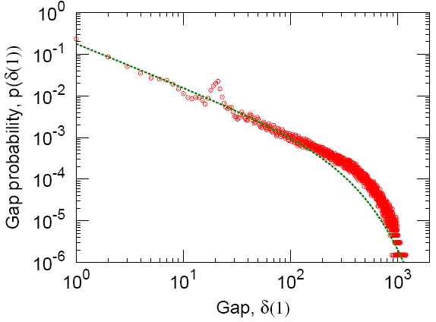
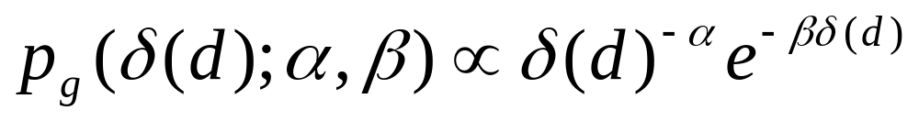
How do edges appear in time?
[LBKT’08]
Edge gap δ(d): inter-arrival time between d^{th} and d+1st edge
LinkedIn
CIKM’08
Copyright: Faloutsos, Tong (2008)
1-<number>

Slide 59
Motivation
Data mining: ~ find patterns (rules, outliers)
Problem#1: How do real graphs look like?
Problem#2: How do they evolve?
  Diameter
  GCC, and NLCC
  linking times, blogs, cascades
Problem#3: Tensor tools?
…

Slide 60
Blog analysis
with Mary McGlohon (CMU)
Jure Leskovec (CMU)
Natalie Glance (now at Google)
Mat Hurst (now at MSR)
[SDM’07]

Slide 61
Cascades on the Blogosphere
B₁
1
a
B₂
B₁
1
B₂
b
c
1
2
d
B₃
1
B₃
B₄
3
e
B₄
Blogosphere
blogs + posts
Blog network
links among blogs
Post network
links among posts
Q1: popularity-decay of a post?
Q2: degree distributions?

Slide 62
Q1: popularity over time
# in links
1
2
3
days after post
Post popularity drops-off – exponentially?
Days after post

Slide 63
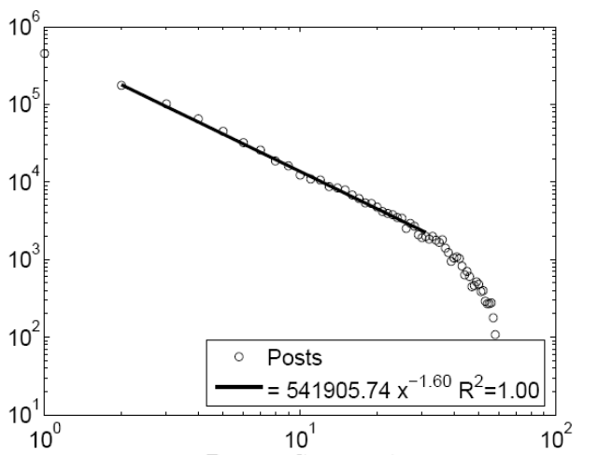
Q1: popularity over time
# in links
(log)
1
2
3
days after post
(log)
Post popularity drops-off – exponentially?
POWER LAW!
Exponent?
Days after post

Slide 64
Q1: popularity over time
# in links
(log)
-1.6
1
2
3
days after post
(log)
Post popularity drops-off – exponentially?
POWER LAW!
Exponent? -1.6 (close to -1.5: Barabasi’s stack model)
Days after post

Slide 65
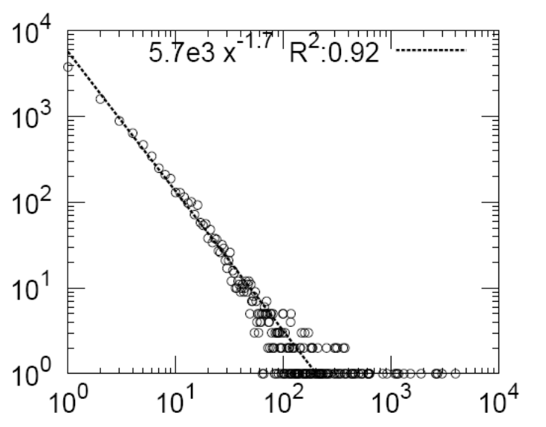
Q2: degree distribution
44,356 nodes, 122,153 edges. Half of blogs belong to largest connected component.
count
??
1
B₁
1
B₂
1
2
B₃
B₄
3
blog in-degree

Slide 66
Q2: degree distribution
44,356 nodes, 122,153 edges. Half of blogs belong to largest connected component.
count
1
B₁
1
B₂
1
2
B₃
B₄
3
blog in-degree

Slide 67
Q2: degree distribution
44,356 nodes, 122,153 edges. Half of blogs belong to largest connected component.
count
in-degree slope: -1.7
out-degree: -3
‘rich get richer’
blog in-degree

Slide 68
Motivation
Data mining: ~ find patterns (rules, outliers)
Problem#1: How do real graphs look like?
Problem#2: How do they evolve?
Problem#3: What tools to use?
  PARAFAC/Tucker, CUR, MDL
  generation: Kronecker graphs
Problem#4: Scalability to GB, TB, PB?

Slide 69
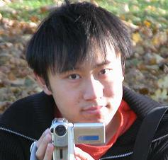
Tensors for time evolving graphs
[Jimeng Sun+ KDD’06]
[ “ , SDM’07]
[ CF, Kolda, Sun, SDM’07 tutorial]

Slide 70
Social network analysis
Static: find community structures
Keywords
1990
s
r
o
h
t
u
DB
A

Slide 71
Social network analysis
Static: find community structures
1992
1991
1990
s
r
o
h
t
u
DB
A

Slide 72
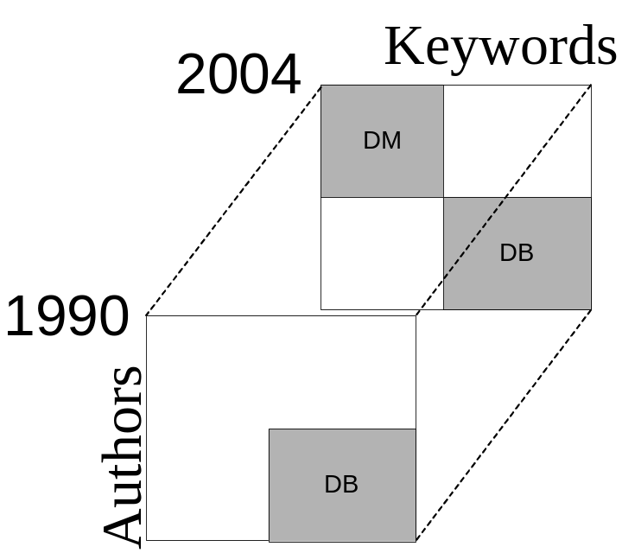
Social network analysis
Static: find community structures
Dynamic: monitor community structure evolution; spot abnormal individuals; abnormal time-stamps

Slide 73
Application 1: Multiway latent semantic indexing (LSI)
2004
Philip Yu
DM
Michael Stonebraker
1990
U_{authors}
DB
authors
U_{keyword}
DB
keyword
Pattern
Query
Projection matrices specify the clusters
Core tensors give cluster activation level

Slide 74
Bibliographic data (DBLP)
Papers from VLDB and KDD conferences
Construct 2nd order tensors with yearly windows with <author, keywords>
Each tensor: 4584×3741
11 timestamps (years)

Slide 75
Multiway LSI
Authors | Keywords | Year
michael carey, michael stonebraker, h. jagadish, hector garcia-molina | queri,parallel,optimization,concurr, objectorient | 1995
surajit chaudhuri,mitch cherniack,michael stonebraker,ugur etintemel | distribut,systems,view,storage,servic,process,cache | 2004
jiawei han,jian pei,philip s. yu, jianyong wang,charu c. aggarwal | streams,pattern,support, cluster, index,gener,queri | 2004
DB
DM
Two groups are correctly identified: Databases and Data mining
People and concepts are drifting over time

Slide 76
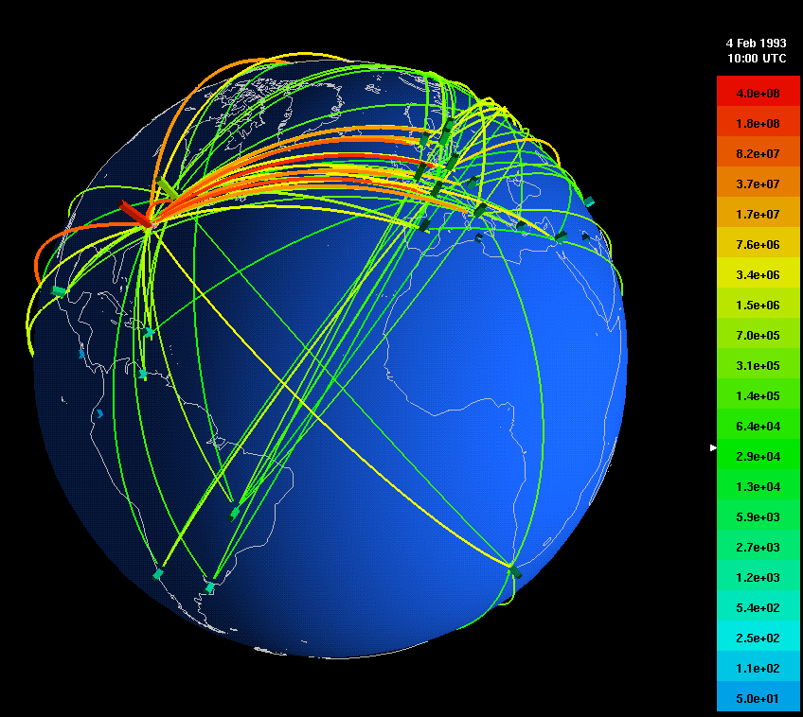
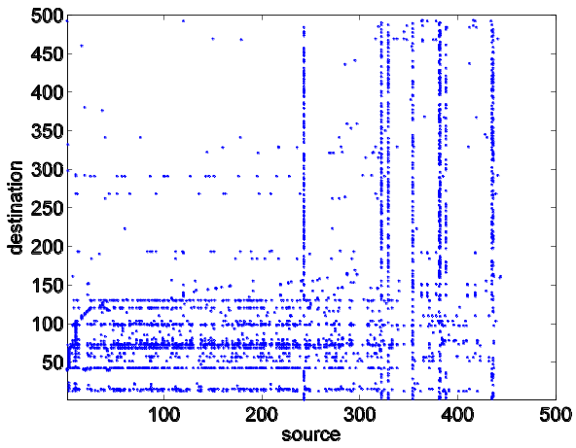
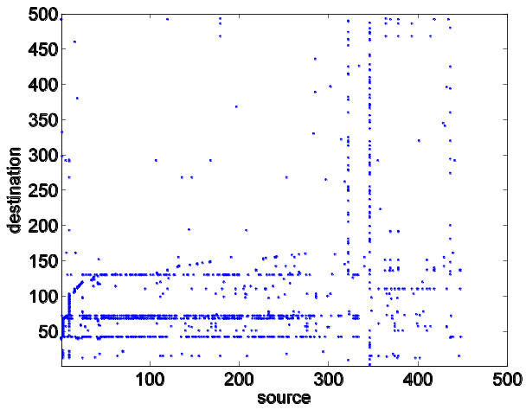
Network forensics
Directional network flows
A large ISP with 100 POPs, each POP 10Gbps link capacity [Hotnets2004]
  450 GB/hour with compression
Task: Identify abnormal traffic pattern and find out the cause
abnormal traffic
normal traffic
destination
destination
source
source
(with Prof. Hui Zhang, Dr. Jimeng Sun, Dr. Yinglian Xie)

Slide 77
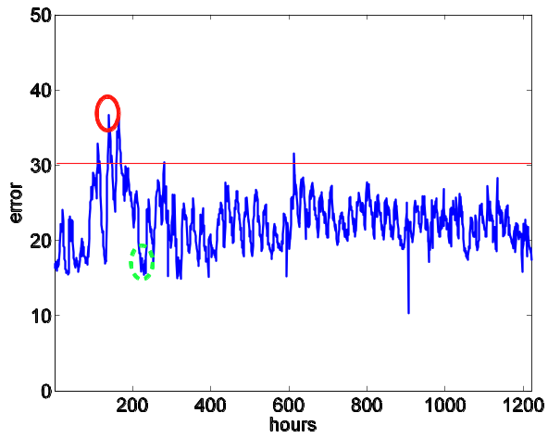
Network forensics
Abnormal traffic
Reconstruction error
over time
Normal traffic
Reconstruction error gives indication of anomalies.
Prominent difference between normal and abnormal ones is mainly due to the unusual scanning activity (confirmed by the campus admin).
Notes:
Faloutsos, Kolda, Sun

Slide 78
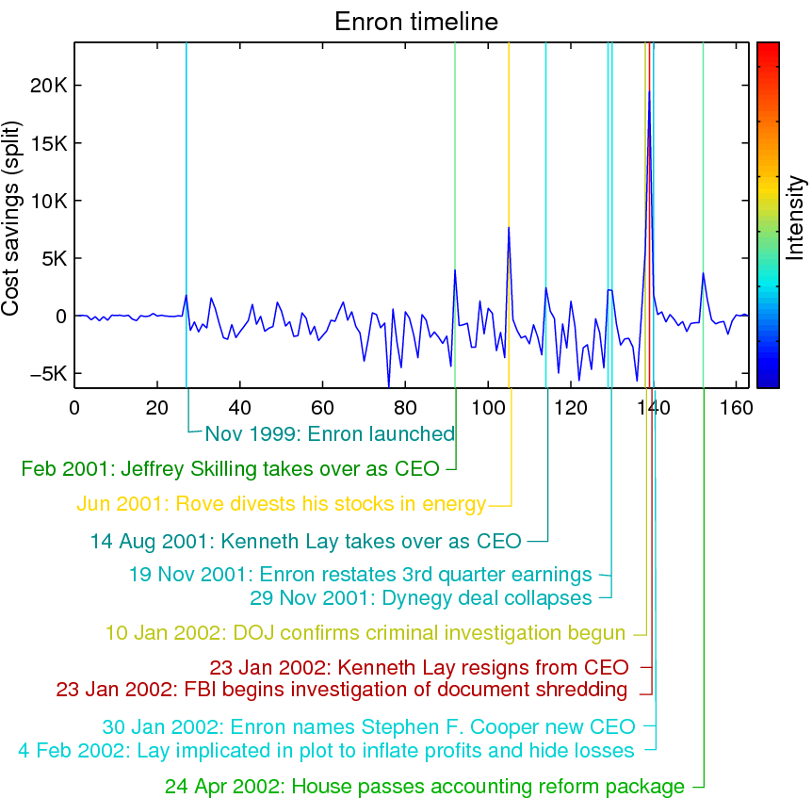
MDL mining on time-evolving graph (Enron emails)
GraphScope [w. Jimeng Sun,
Spiros Papadimitriou and Philip Yu, KDD’07]

Slide 79
Motivation
Data mining: ~ find patterns (rules, outliers)
Problem#1: How do real graphs look like?
Problem#2: How do they evolve?
Problem#3: What tools to use?
  PARAFAC/Tucker, CUR, MDL
  generation: Kronecker graphs
Problem#4: Scalability to GB, TB, PB?

Slide 80
Problem#3: Tools - Generation
Given a growing graph with count of nodes N₁, N₂, …
Generate a realistic sequence of graphs that will obey all the patterns

Slide 81
Problem Definition
Given a growing graph with count of nodes N₁, N₂, …
Generate a realistic sequence of graphs that will obey all the patterns
  Static Patterns
    Power Law Degree Distribution
    Power Law eigenvalue and eigenvector distribution
    Small Diameter
  Dynamic Patterns
    Growth Power Law
    Shrinking/Stabilizing Diameters

Slide 82
Problem Definition
Given a growing graph with count of nodes N₁, N₂, …
Generate a realistic sequence of graphs that will obey all the patterns
Idea: Self-similarity
  Leads to power laws
  Communities within communities
  …

Slide 83
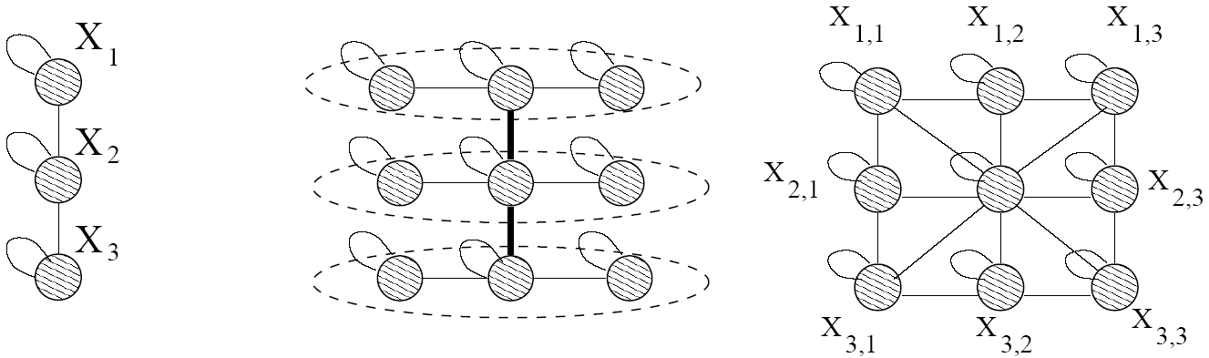
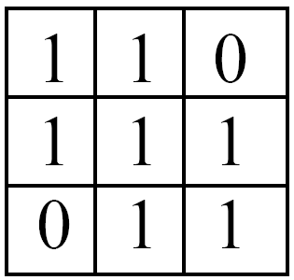



Kronecker Product – a Graph
Intermediate stage
Adjacency matrix
Adjacency matrix

Slide 84

Kronecker Product – a Graph
Continuing multiplying with G₁ we obtain G₄ and so on …
G₄ adjacency matrix

Slide 85
Kronecker Product – a Graph
Continuing multiplying with G₁ we obtain G₄ and so on …
G₄ adjacency matrix

Slide 86
Kronecker Product – a Graph
Continuing multiplying with G₁ we obtain G₄ and so on …
G₄ adjacency matrix

Slide 87
Properties:
We can PROVE that
  Degree distribution is multinomial ~ power law
  Diameter: constant
  Eigenvalue distribution: multinomial
  First eigenvector: multinomial
See [Leskovec+, PKDD’05] for proofs

Slide 88
Problem Definition
Given a growing graph with nodes N₁, N₂, …
Generate a realistic sequence of graphs that will obey all the patterns
  Static Patterns
    Power Law Degree Distribution
    Power Law eigenvalue and eigenvector distribution
    Small Diameter
  Dynamic Patterns
    Growth Power Law
    Shrinking/Stabilizing Diameters
First and only generator for which we can prove all these properties
✓
✓
✓
✓
✓

Slide 89
Stochastic Kronecker Graphs
skip
Create N₁×N₁ probability matrix P₁
Compute the k^{th} Kronecker power P_{k}
For each entry p_{uv} of P_{k} include an edge (u,v) with probability p_{uv}
Kronecker
multiplication
0.16 | 0.08 | 0.08 | 0.04
0.04 | 0.12 | 0.02 | 0.06
0.04 | 0.02 | 0.12 | 0.06
0.01 | 0.03 | 0.03 | 0.09
0.4 | 0.2
0.1 | 0.3
Instance
Matrix G₂
P₁
flip biased
coins
P_{k}

Slide 90
Experiments
How well can we match real graphs?
  Arxiv: physics citations:
    30,000 papers, 350,000 citations
    10 years of data
  U.S. Patent citation network
    4 million patents, 16 million citations
    37 years of data
  Autonomous systems – graph of internet
    Single snapshot from January 2002
    6,400 nodes, 26,000 edges
We show both static and temporal patterns

Slide 91
(Q: how to fit the parm’s?)
A:
Stochastic version of Kronecker graphs +
Max likelihood +
Metropolis sampling
[Leskovec+, ICML’07]

Slide 92




Experiments on real AS graph
Degree distribution
Hop plot
Adjacency matrix eigen values
Network value

Slide 93
Conclusions
Kronecker graphs have:
  All the static properties
    Heavy tailed degree distributions
    Small diameter
    Multinomial eigenvalues and eigenvectors
  All the temporal properties
    Densification Power Law
    Shrinking/Stabilizing Diameters
  We can formally prove these results
✓
✓
✓
✓
✓
Notes:
CHECKMARKS

Slide 94
How to generate realistic tensors?
A: ‘RTM’ [Akoglu+, ICDM’08]
  do a tensor-tensor Kronecker product
  resulting tensors (= time evolving graphs) have bursty addition of edges, over time.

Slide 95
Motivation
Data mining: ~ find patterns (rules, outliers)
Problem#1: How do real graphs look like?
Problem#2: How do they evolve?
Problem#3: What tools to use?
Problem#4: Scalability to GB, TB, PB?

Slide 96
Scalability
How about if graph/tensor does not fit in core?
How about handling huge graphs?

Slide 97
Scalability
How about if graph/tensor does not fit in core?
[‘MET’: Kolda, Sun, ICMD’08, best paper award]
How about handling huge graphs?

Slide 98

Scalability
Google: > 450,000 processors in clusters of ~2000 processors each [Barroso, Dean, Hölzle, “Web Search for a Planet: The Google Cluster Architecture” IEEE Micro 2003]
Yahoo: 5Pb of data [Fayyad, KDD’07]
Problem: machine failures, on a daily basis
How to parallelize data mining tasks, then?
A: map/reduce – hadoop (open-source clone) http://hadoop.apache.org/
Notes:
Faloutsos et al

Slide 99
2’ intro to hadoop
master-slave architecture; n-way replication (default n=3)
‘group by’ of SQL (in parallel, fault-tolerant way)
e.g, find histogram of word frequency
  compute local histograms
  then merge into global histogram
select course-id, count(*)
from ENROLLMENT
group by course-id

Slide 100
2’ intro to hadoop
master-slave architecture; n-way replication (default n=3)
‘group by’ of SQL (in parallel, fault-tolerant way)
e.g, find histogram of word frequency
  compute local histograms
  then merge into global histogram
select course-id, count(*)
from ENROLLMENT
group by course-id
reduce
map

Slide 101
User
Program
fork
fork
fork
Master
assign
map
assign
reduce
Input Data
(on HDFS)
Mapper
write
Output
File 0
local
write
Reducer
Split 0
read
Split 1
Mapper
Split 2
Output
File 1
Reducer
Mapper
remote read,
sort
By default: 3-way replication;
Late/dead machines: ignored, transparently (!)

Slide 102

D.I.S.C.
‘Data Intensive Scientific Computing’ [R. Bryant, CMU]
  ‘big data’
  http://www.cs.cmu.edu/~bryant/pubdir/cmu-cs-07-128.pdf

Slide 103


E.g.: self-* and DCO systems @ CMU
>200 nodes
target: 1 PetaByte
Greg Ganger +:
  www.pdl.cmu.edu/SelfStar
  www.pdl.cmu.edu/DCO
Notes:
Faloutsos et al
PT bytes, self-*, linux, gigabit link?

Slide 104
OVERALL CONCLUSIONS
Graphs/tensors pose a wealth of fascinating problems
self-similarity and power laws work, when textbook methods fail!
New patterns (densification, fortification, -1.5 slope in blog popularity over time
New generator: Kronecker
Scalability / cloud computing -> PetaBytes

Slide 105
References
Hanghang Tong, Christos Faloutsos, and Jia-Yu Pan Fast Random Walk with Restart and Its Applications ICDM 2006, Hong Kong.
Hanghang Tong, Christos Faloutsos Center-Piece Subgraphs: Problem Definition and Fast Solutions, KDD 2006, Philadelphia, PA
T. G. Kolda and J. Sun. Scalable Tensor Decompositions for Multi-aspect Data Mining. In: ICDM 2008, pp. 363-372, December 2008.

Slide 106
References
Jure Leskovec, Jon Kleinberg and Christos Faloutsos Graphs over Time: Densification Laws, Shrinking Diameters and Possible Explanations KDD 2005, Chicago, IL. ("Best Research Paper" award).
Jure Leskovec, Deepayan Chakrabarti, Jon Kleinberg, Christos Faloutsos Realistic, Mathematically Tractable Graph Generation and Evolution, Using Kronecker Multiplication
(ECML/PKDD 2005), Porto, Portugal, 2005.

Slide 107
References
Jure Leskovec and Christos Faloutsos, Scalable Modeling of Real Graphs using Kronecker Multiplication, ICML 2007, Corvallis, OR, USA
Shashank Pandit, Duen Horng (Polo) Chau, Samuel Wang and Christos Faloutsos NetProbe: A Fast and Scalable System for Fraud Detection in Online Auction Networks WWW 2007, Banff, Alberta, Canada, May 8-12, 2007.
Jimeng Sun, Dacheng Tao, Christos Faloutsos Beyond Streams and Graphs: Dynamic Tensor Analysis, KDD 2006, Philadelphia, PA

Slide 108
References
Jimeng Sun, Yinglian Xie, Hui Zhang, Christos Faloutsos. Less is More: Compact Matrix Decomposition for Large Sparse Graphs, SDM, Minneapolis, Minnesota, Apr 2007. [pdf]
Jimeng Sun, Spiros Papadimitriou, Philip S. Yu, and Christos Faloutsos, GraphScope: Parameter-free Mining of Large Time-evolving Graphs ACM SIGKDD Conference, San Jose, CA, August 2007

Slide 109

THANK YOU!
Contact info:
www. cs.cmu.edu /~christos
(w/ papers, datasets, code, etc)
Funding sources:
NSF IIS-0705359, IIS-0534205, DBI-0640543
LLNL, PITA, IBM, INTEL

